Slide 1
Group 6
Moeurn Puthsitha
Chan Sokheang
Yep Chichay
Sun Veasna
Ren vicheka
YI Yin
Sren chantry
Hab Sal
Seang Chandara
Chea sopheak

Slide 2
How to install centOs in Vmware?

Slide 3
CentOs 7 64 bit

Slide 4
Requirement
Thing you need to have!
Vmware : https://www.vmware.com/products/workstation-pro/workstation-pro-evalu ation.html
CentOs ISO file : http://mirror.sabay.com.kh/centos/7.9.2009/isos/x86_64/ (dvd file )

Slide 5
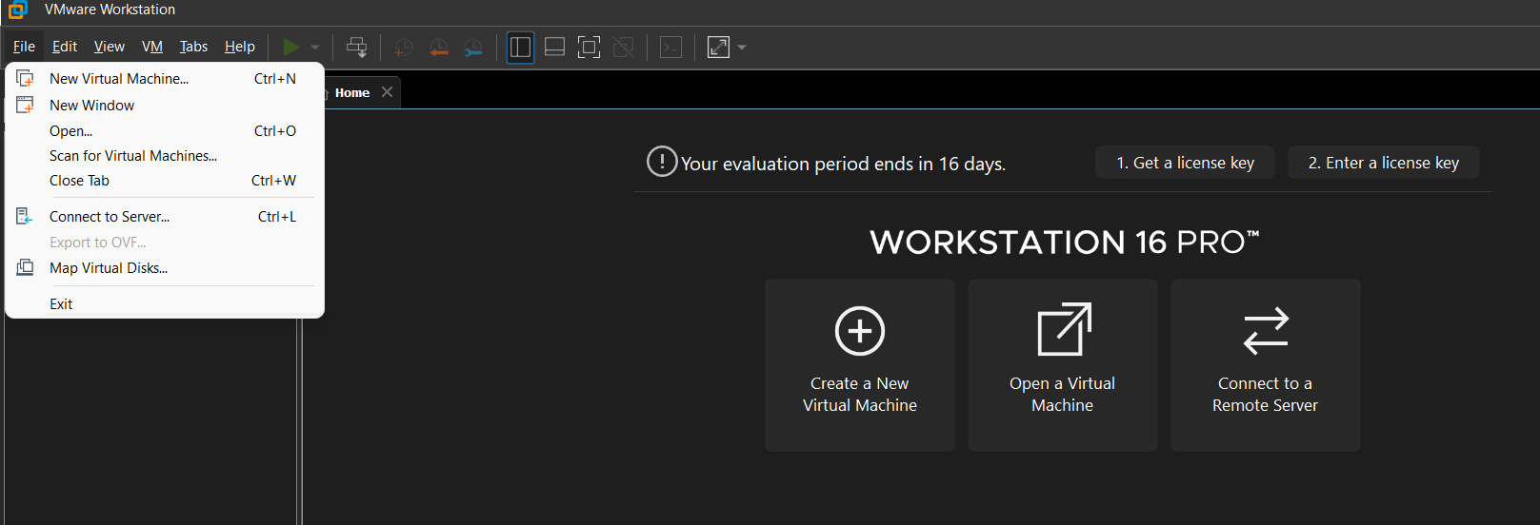
Create New VM

Slide 6
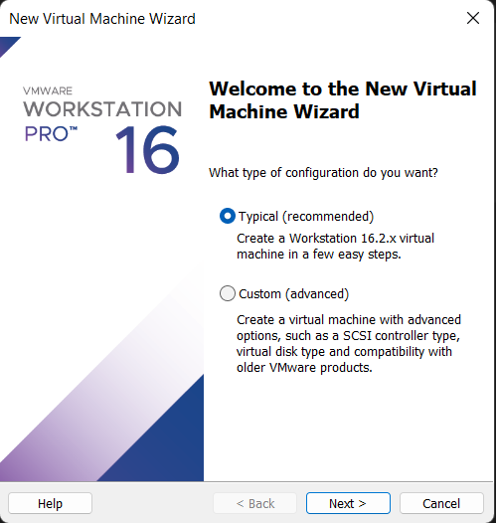
Chose type of Configuration
I chose Typical (by recommended) easy than Custom

Slide 7
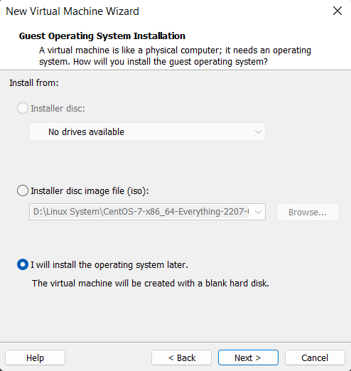
Browse File ISO
យក option មួយហ្នឹងចាំដាក់ file iso ក្រោយ
រួចចុច next

Slide 8
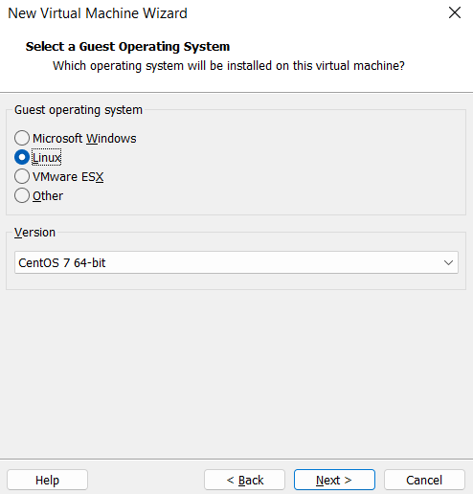
Select Operation System
Select Linux
And Version 7 64 bit

Slide 9
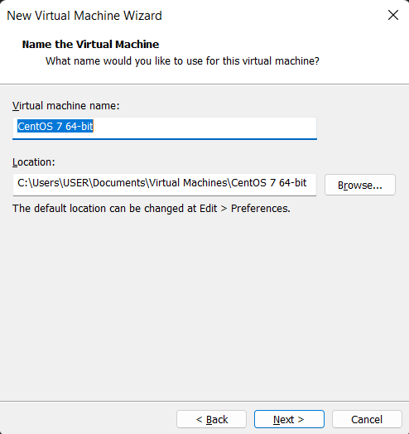
Name & Location
ដាក់ឈ្មោះ machine និង ទីតាំងនៅក្នុង computer របស់អ្នក
ចុច next

Slide 10
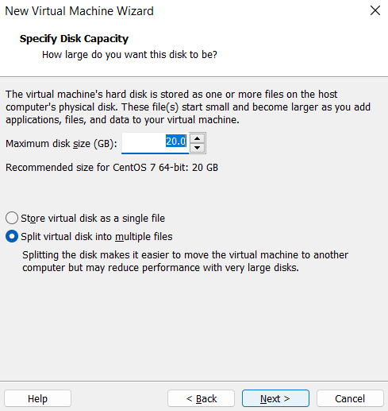
Custom Disk
យក 20 GB ដែល recommend

Slide 11
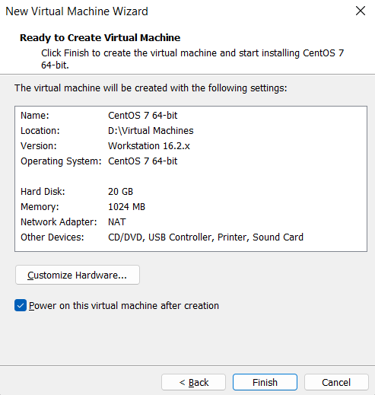
Are you sure or wanna check again

Slide 12
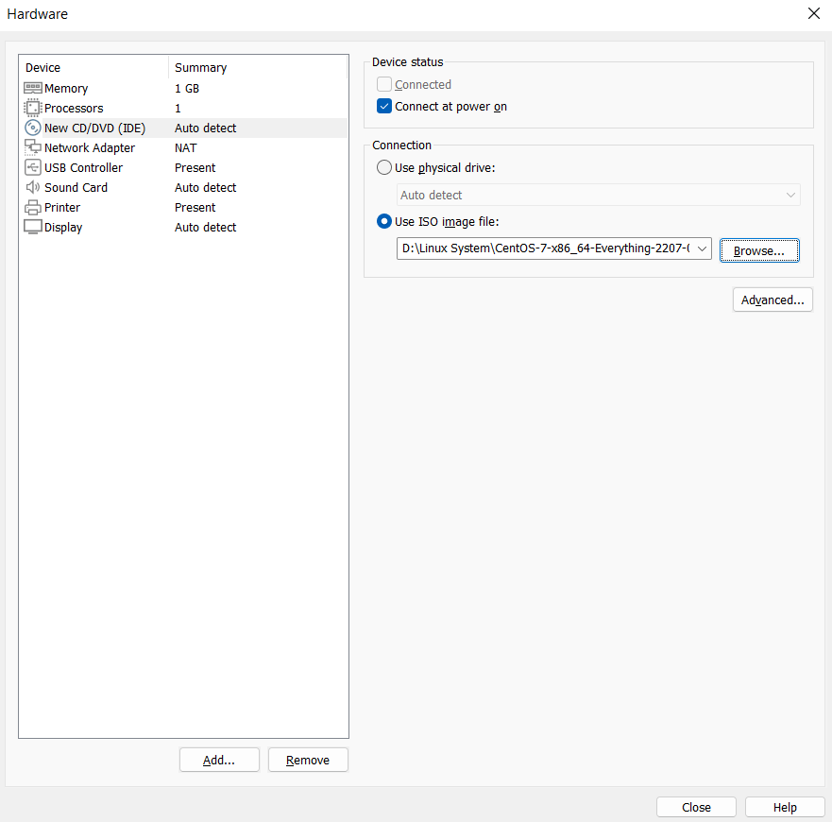
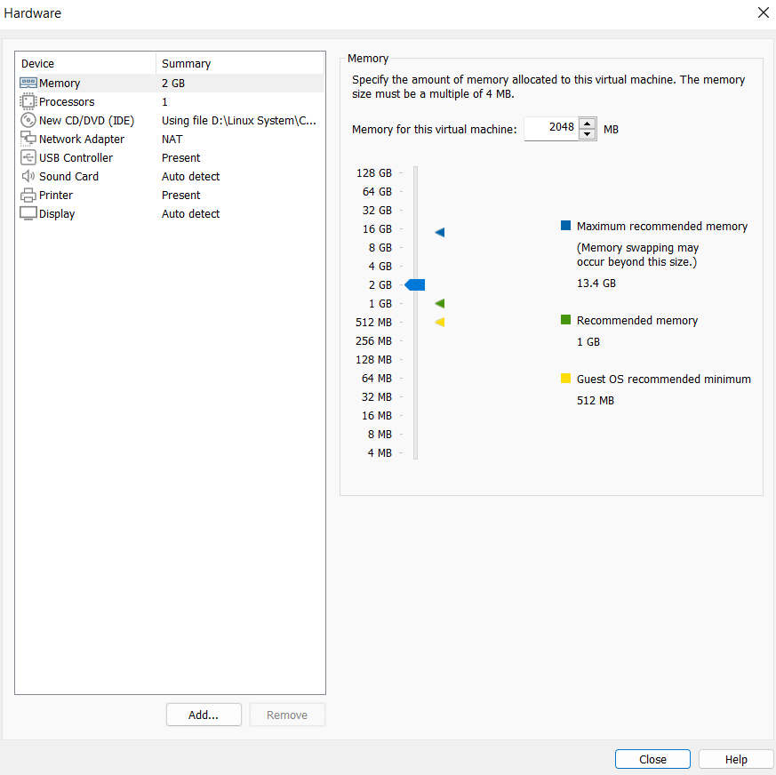
Custom Hardware

Slide 13
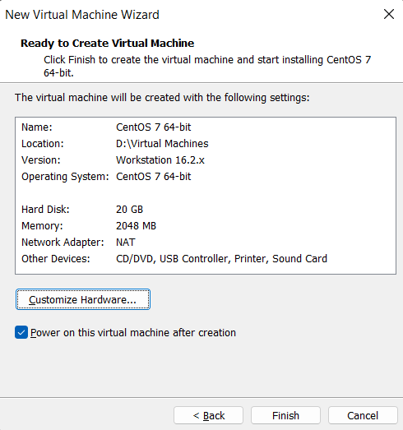
Click Finish

Slide 14
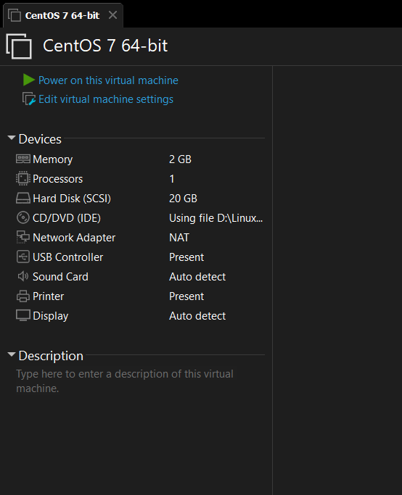
Boot Your CentOs

Slide 15
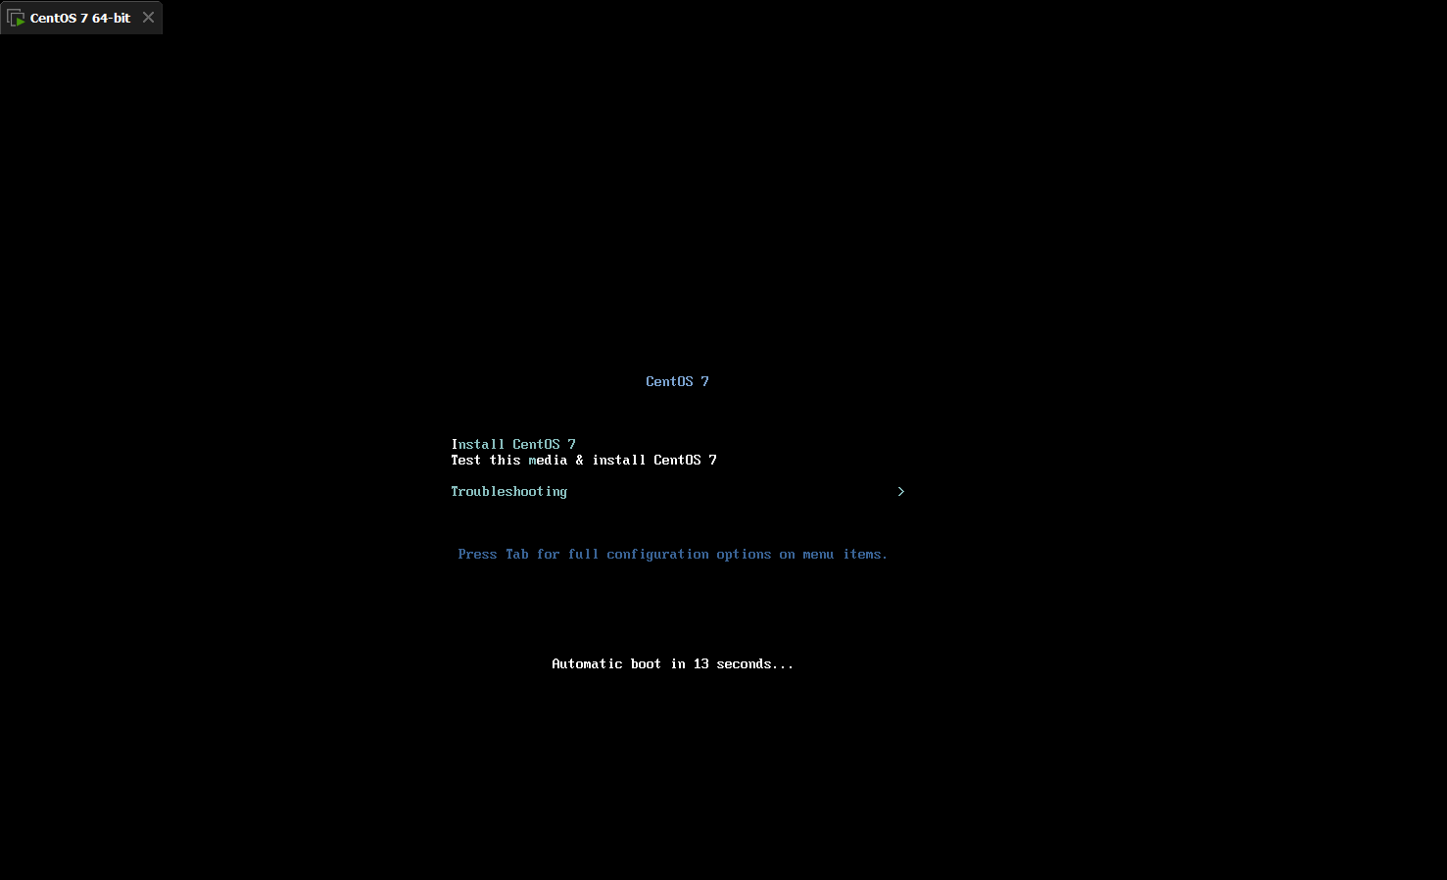

Slide 16
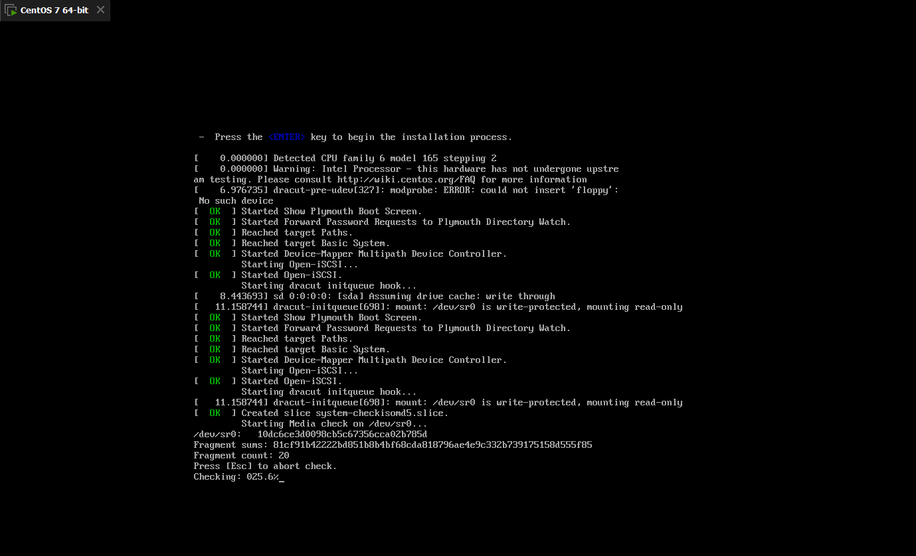

Slide 17
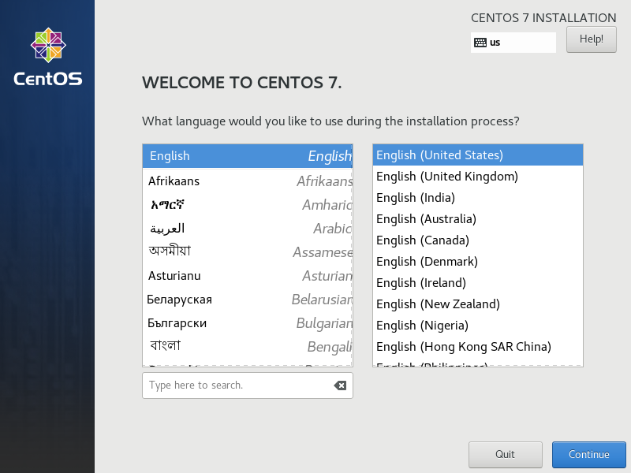
Language

Slide 18
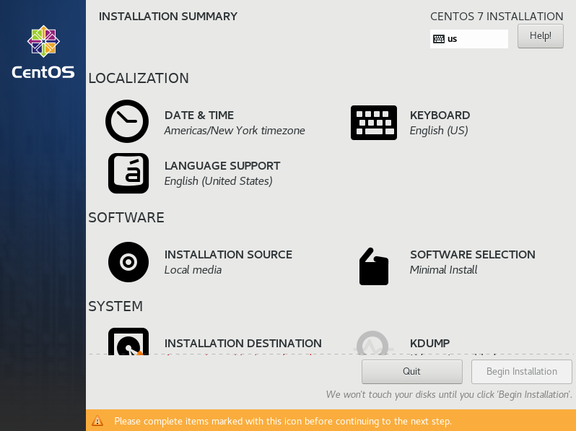
Installation
Date & Time
Software Selection
Installation Destination Disk

Slide 19
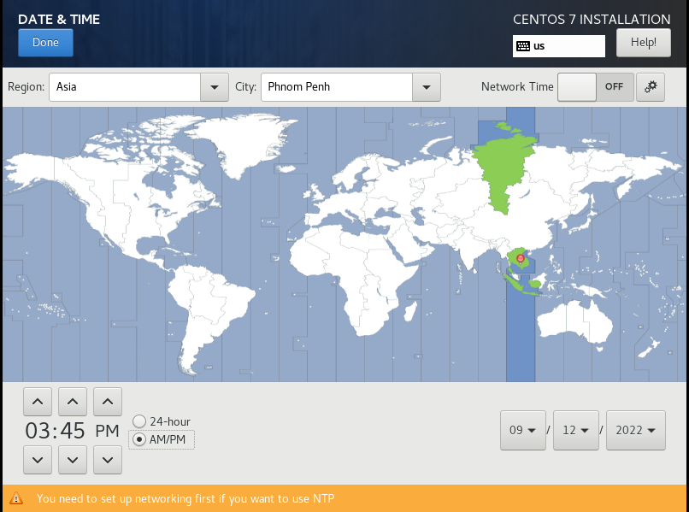
Select Current and Correct Local
Asia & PhnomPhen

Slide 20
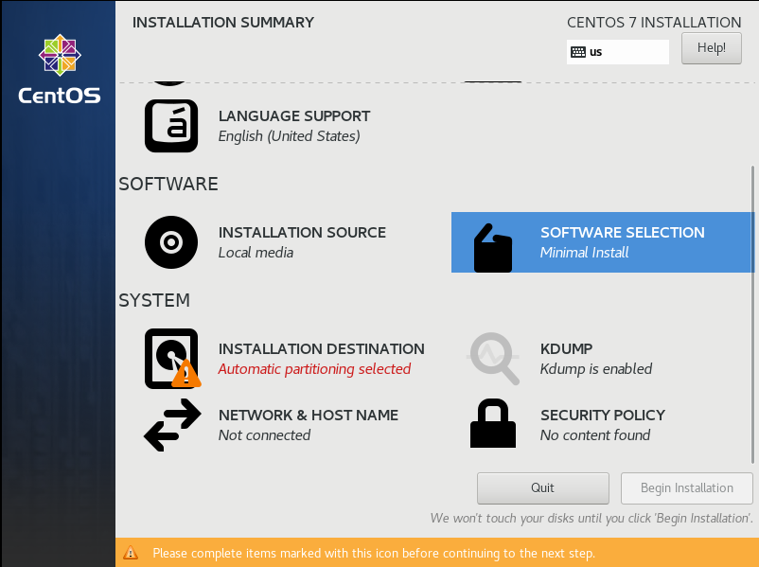
2. Software Selection
Select type of software

Slide 21
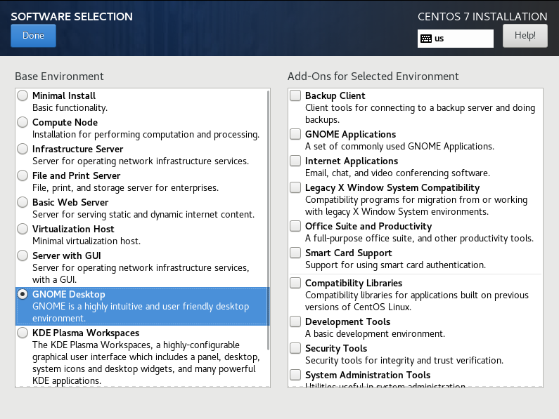
GNOME Desktop
Easy to Look

Slide 22
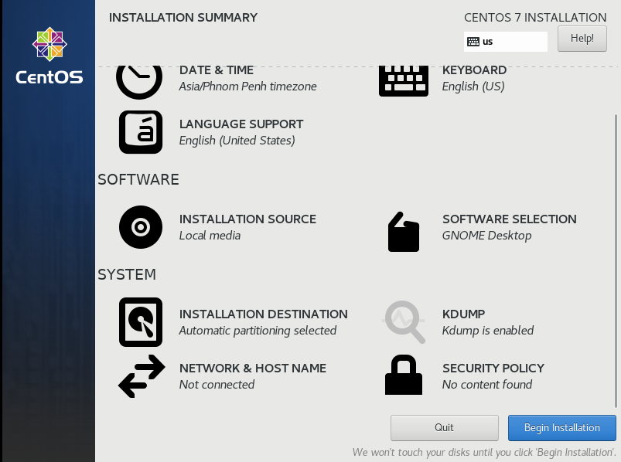
Select Disk

Slide 23
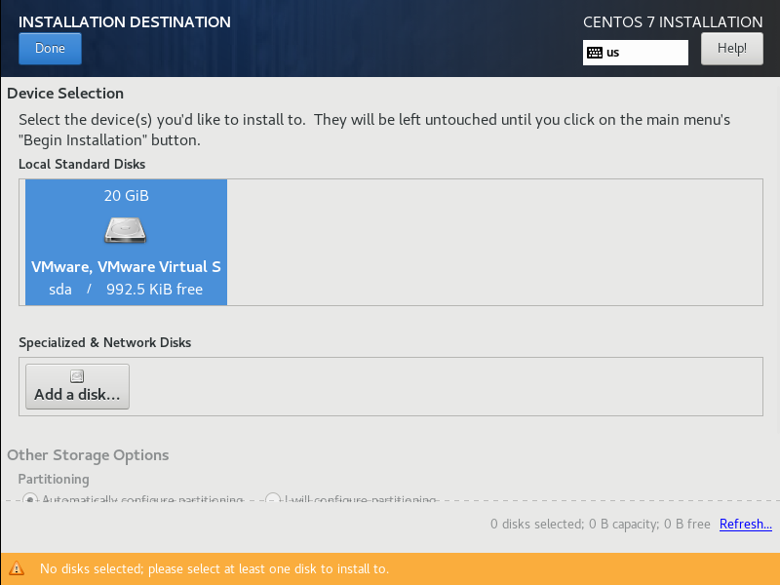
Select Disk

Slide 24
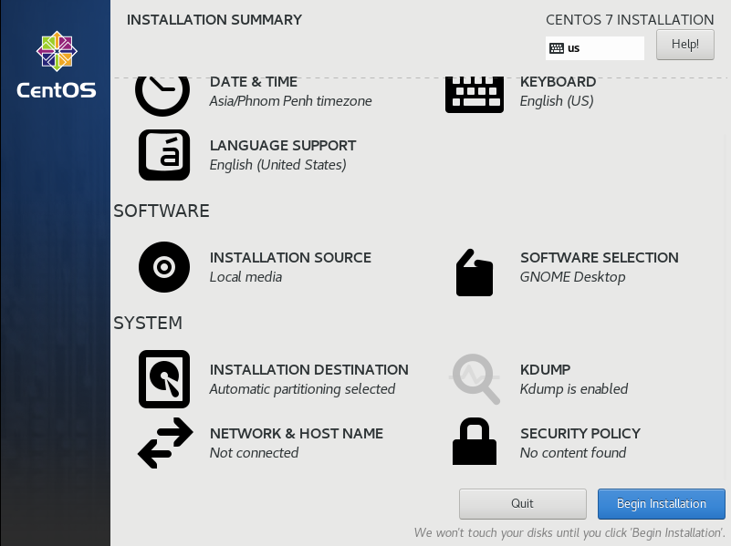
Click Begin Installation

Slide 25
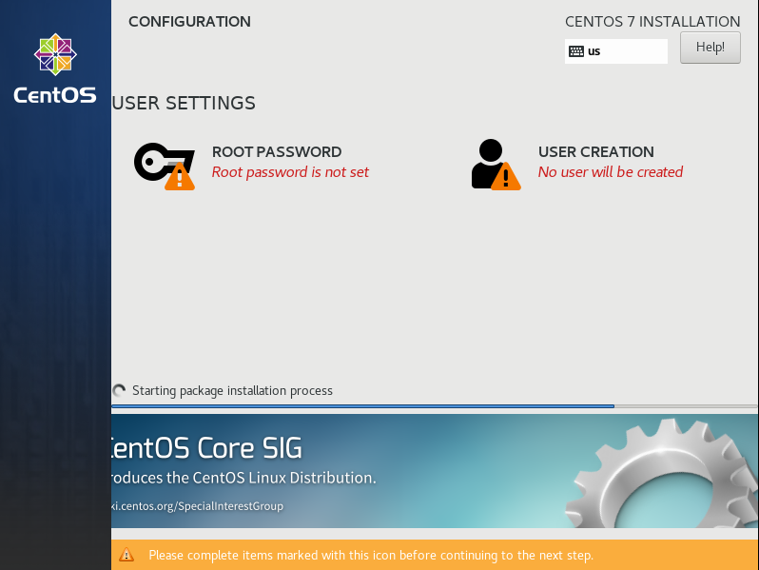
Config User Setting
Root Password
User Creation

Slide 26
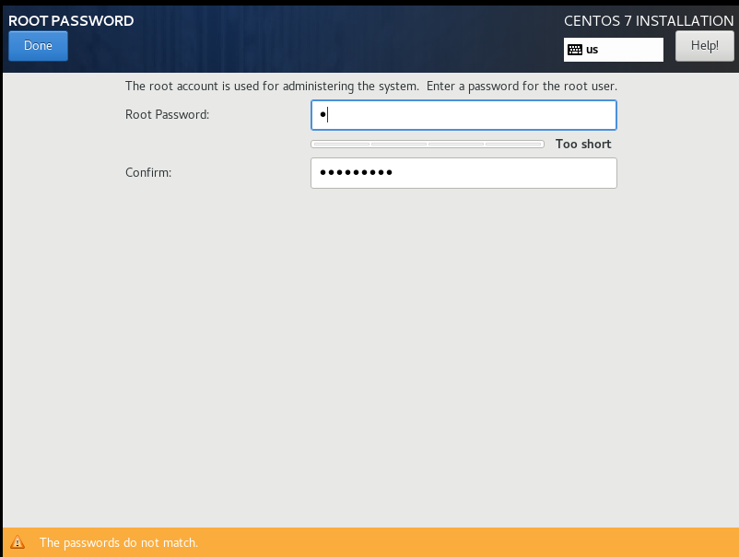
Root Password

Slide 27
User Creation

Slide 28
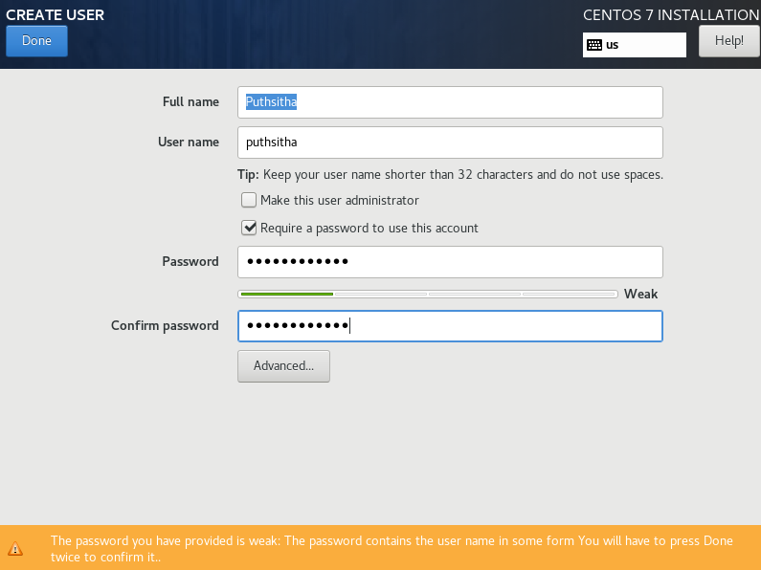
Create User

Slide 29
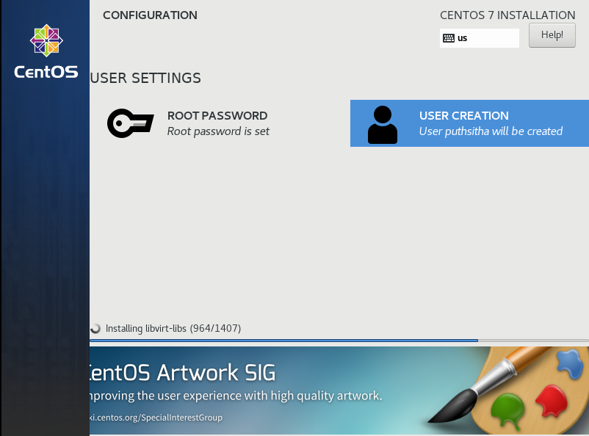
After Done
ចាំមួយសន្ទុះ
កំពុងធ្វើការ installation
Just wait

Slide 30
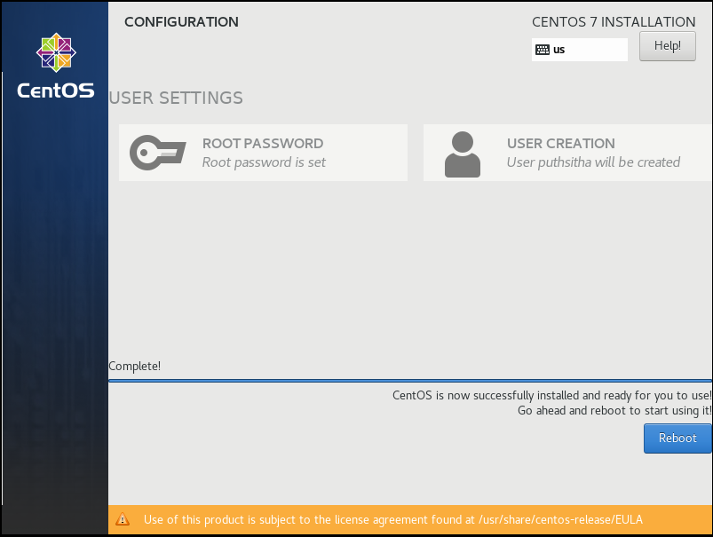
After Installation Complete
Click Reboot

Slide 31
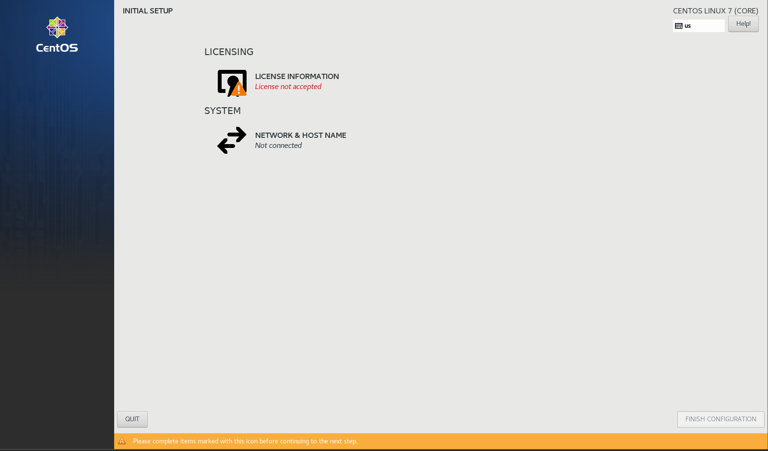

Slide 32
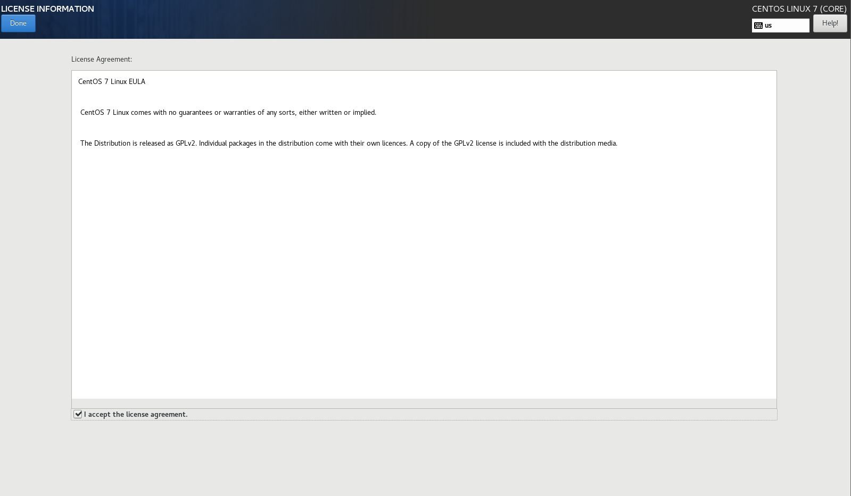

Slide 33
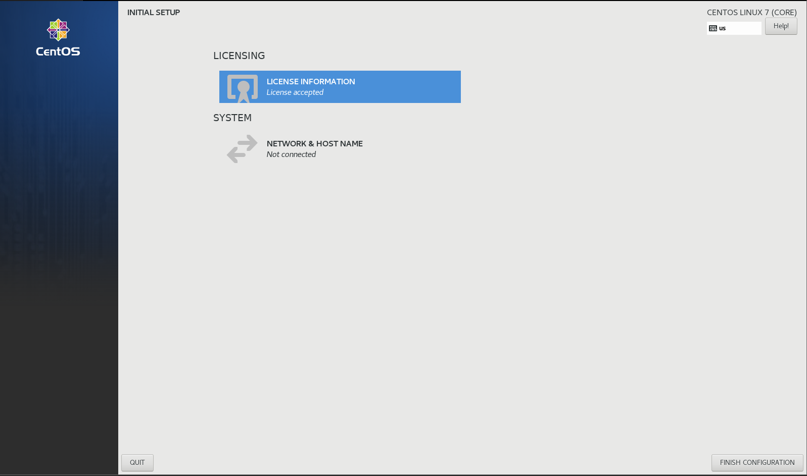

Slide 34
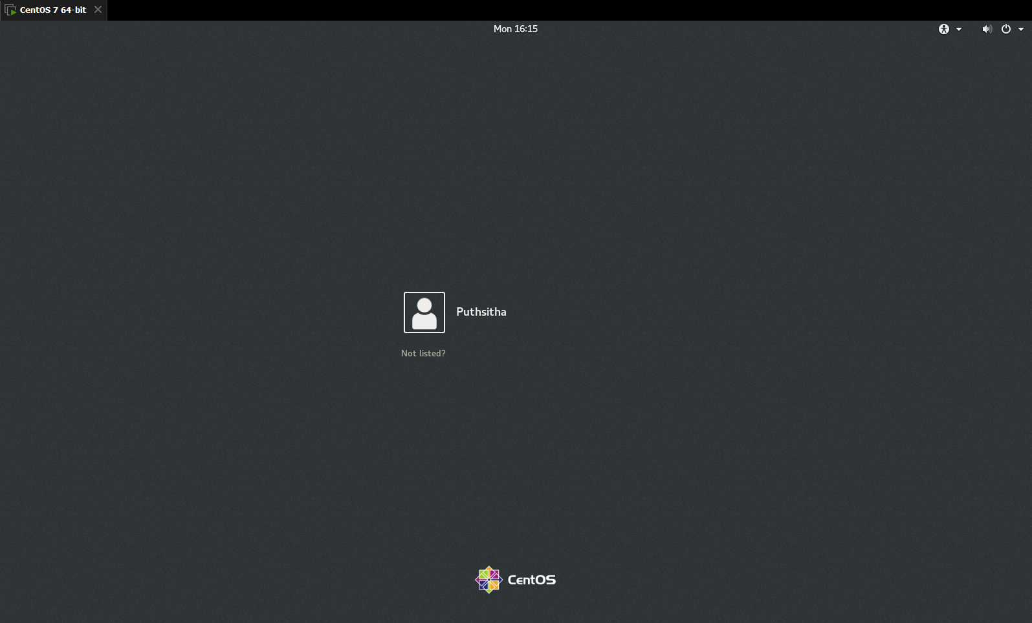

Slide 35
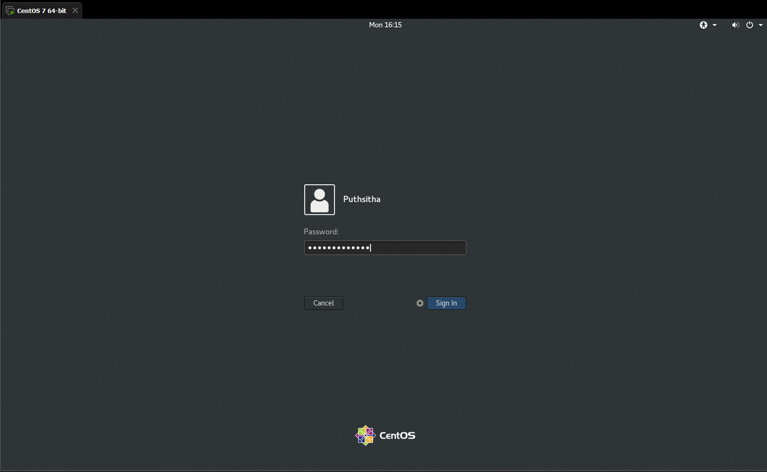

Slide 36
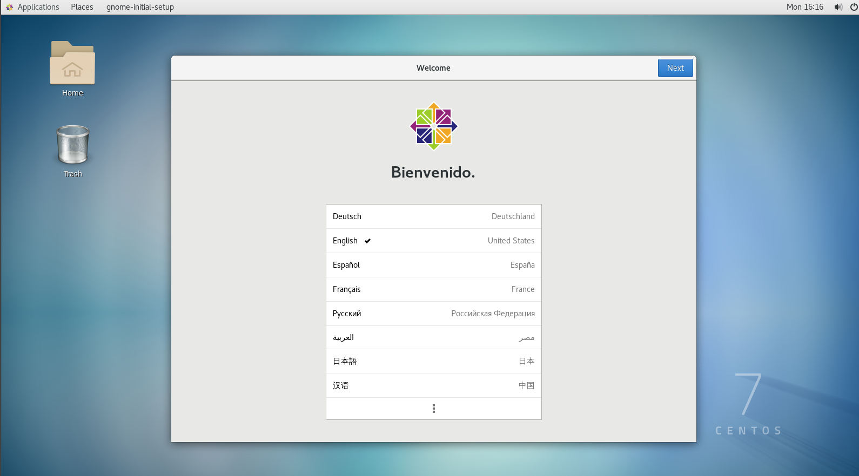

Slide 37
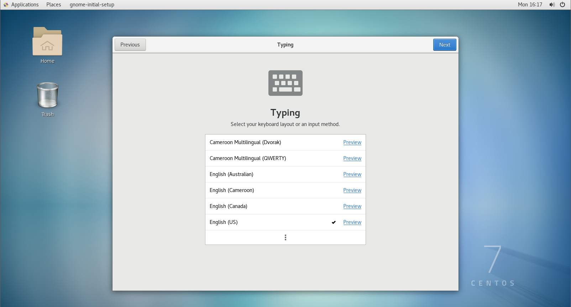

Slide 38
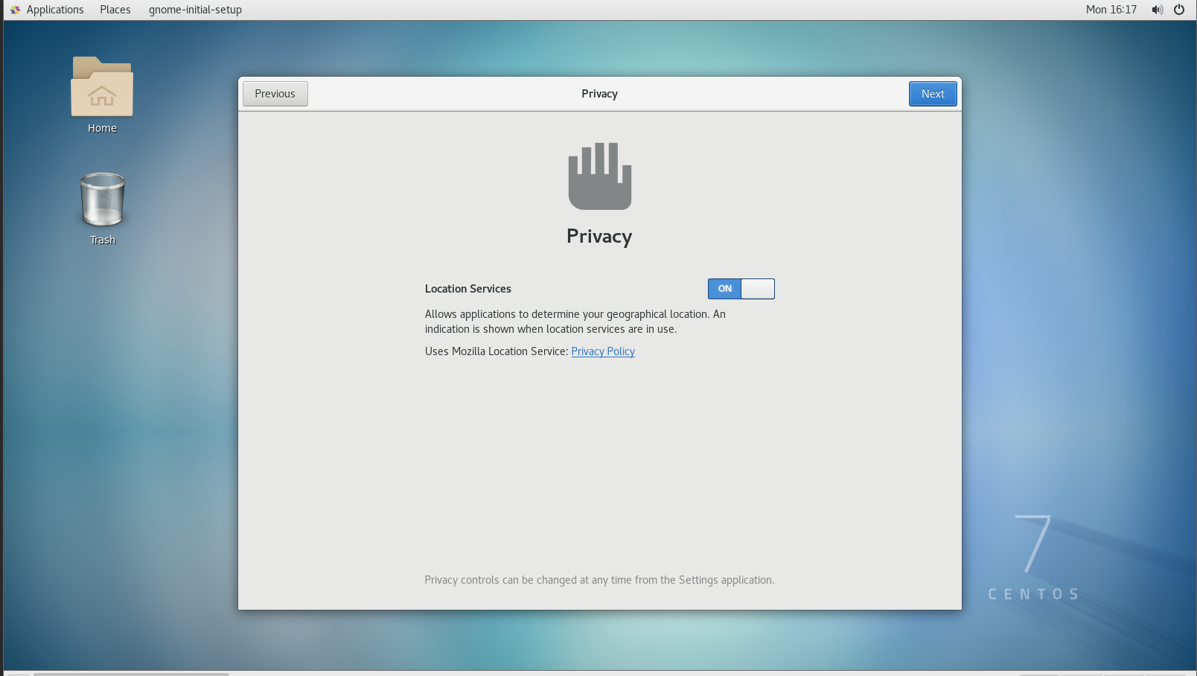

Slide 39
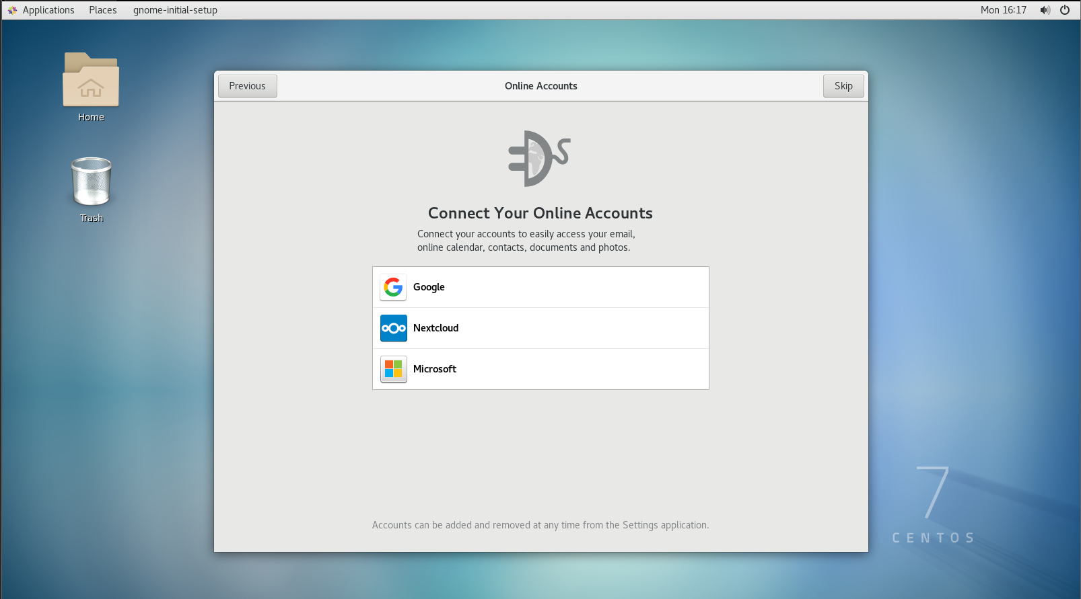

Slide 40
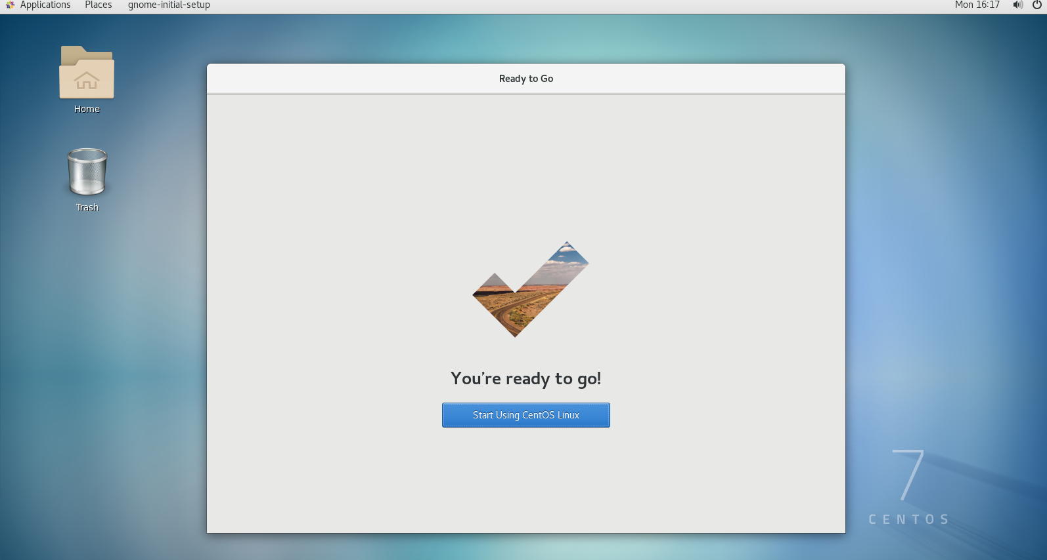

Slide 41
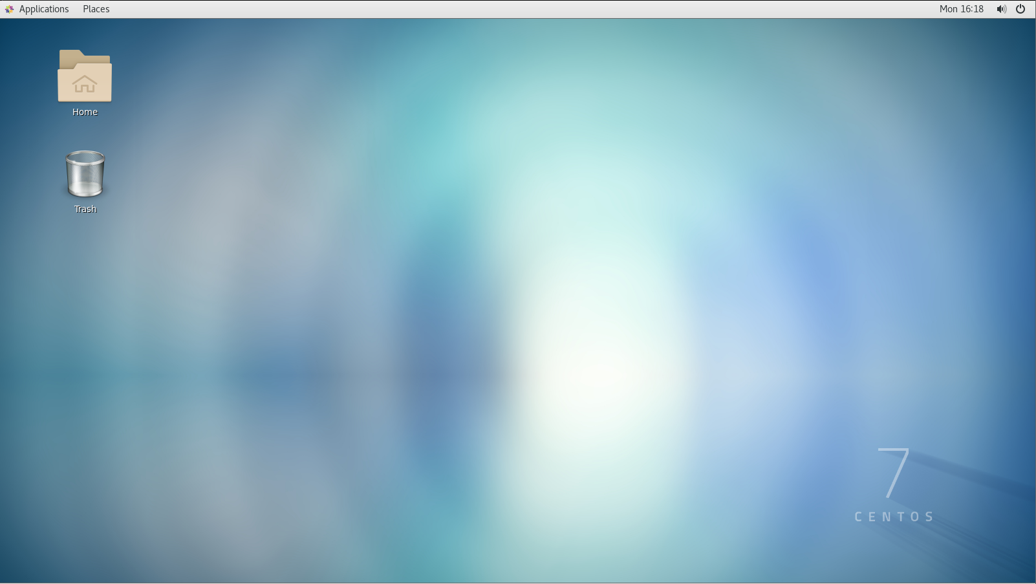

Slide 42
Conclusion
Thank you for watching, and listening
Link Video : https://www.youtube.com/watch?v=0_cjytCZ4bE
Link Chanel : https://www.youtube.com/channel/UC5GF7UAZFa3UaJLFqANpGyw

